Slide 1
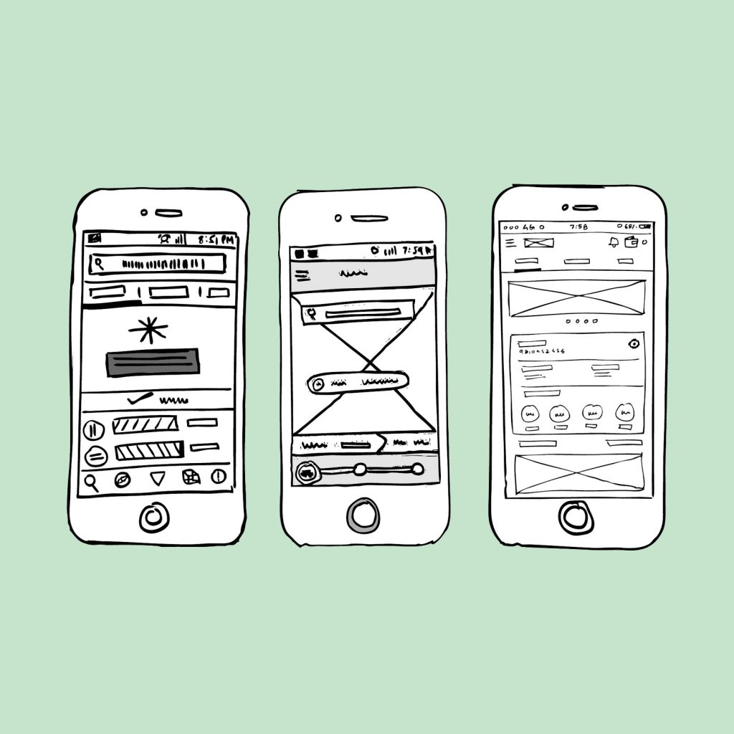
LOW FIDELITY AND HIGH FIDELITY PROTOTYPE
LOW FIDELITY PROTOTYPE
Low-fi prototypes. A low-fi prototype is a computer-based visual representation of a digital product
with little resemblance to the final design. It can take on a lot of different forms,
from simple black&white sketches to colorful layout drafts
HIGH FIDELITY PROTOTYPE
High-fidelity prototypes are computer-based, and usually
allow realistic (mouse-keyboard) user interactions.
High-fidelity prototypes take you as close as possible
to a true representation of the user interface.

Slide 2
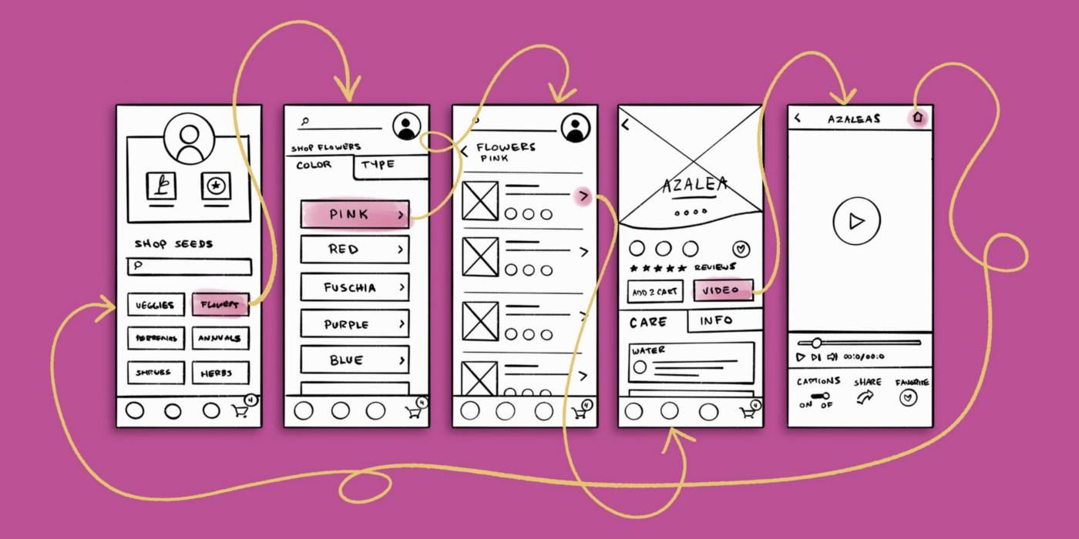
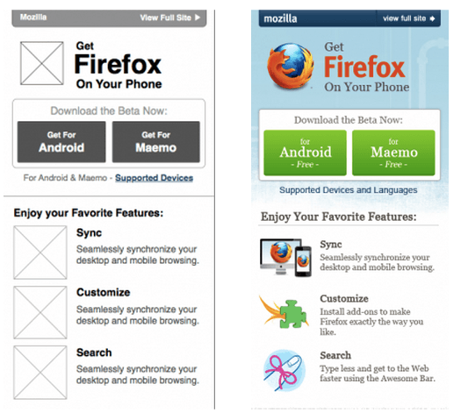
EXAMPLE OF LOWFIDELITY AND HIGH FIDELITY PROTOTYPE

